Slide 1
Comets Attend
By Anuja, Apoorva, Shradha and Siddhi
BUAN 6320.006

Slide 2
Team
Anuja Thakar
Apoorva Shukla
Shradha Sharma
Siddhi Javalkar

Slide 3


Introduction
Comet Attends aims to be an attendance tracking system that will enable a professor teaching multiple courses and sections to centrally track attendance for all courses in one system and enable a student to mark their attendance for multiple courses they take for the semester.

Slide 4
Attendance Management System
System Workflow
Tables
Data Import
Queries
User Interface
Summary

Slide 5

System Workflow The way to get started is to quit talking and begin doing.
Walt Disney

Slide 6
System Workflow
Gather Requirements
We analyzed a professor’s requirement to note class attendance and students to mark their attendance
Listed scenarios and data addressing the problem statement.
Conceptual & Logical Design
After analyzing the data we decided on the system design
An Entity Relationship Diagram was made which formed the basic foundation of the system
The 12 tables are as named ahead

Slide 7
System Workflow
Physical Design
Taking the ERD as our base we created our entity tables and defined respective attributes.
Create queries were used to establish entities and their attributes
Data was imported using .csv files into the mysql work bench’s data import wizard
User Interface
UI is designed to keep the journey approach from both professor and student perspectives.
Ensure simple and minimalistic appraoch

Slide 8
Tables
List of Tables used in the System

Slide 9
Tables
1: University
2: School
3: Department
4: Professor
5: Students
6: Course
7: Leave Type
8: Holiday
9: Allowed Leaves
10: Test Days
11: Student Course
12: Student Holiday

Slide 10
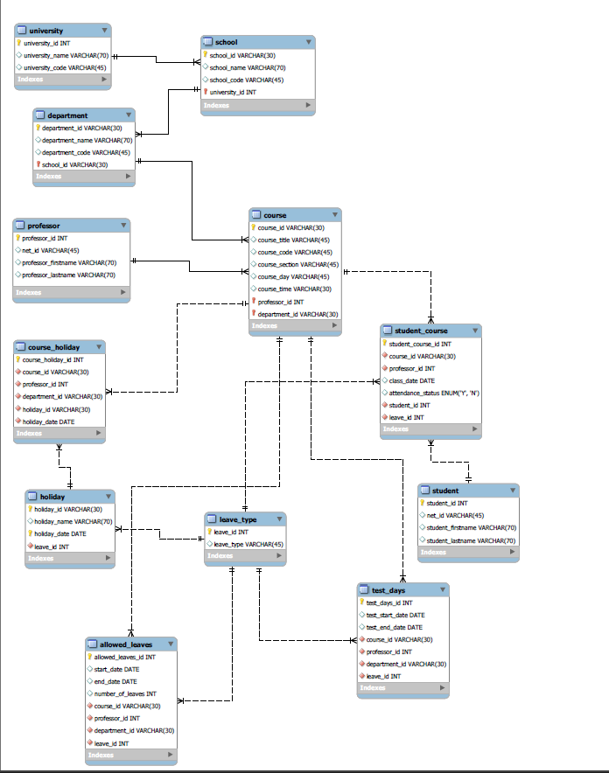
Entity Relationship Diagram

Slide 11
Entity Relationship Diagram

Slide 12
Data
Data Collection and Import

Slide 13
Data
Data Collection
Dummy data from data generator
Data from University Websites
Data creation using Excel
Data Import
Insert into statement
We then made csv files for different entities.
Imported data in MySql using the data import wizard

Slide 14
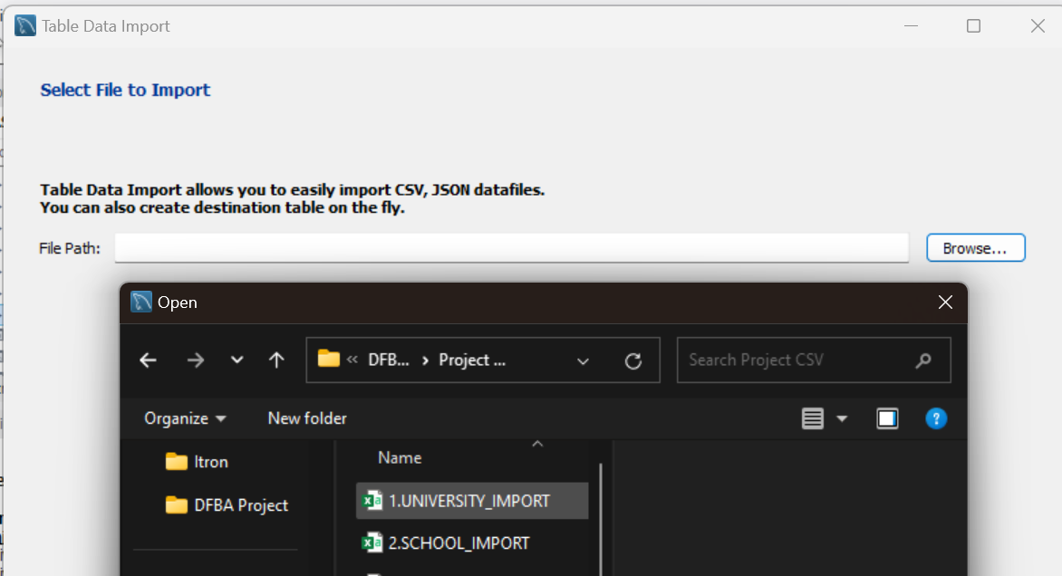
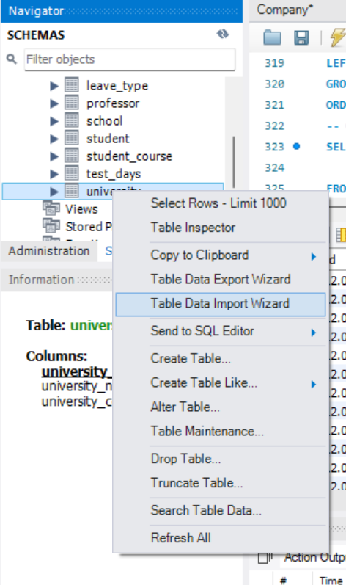
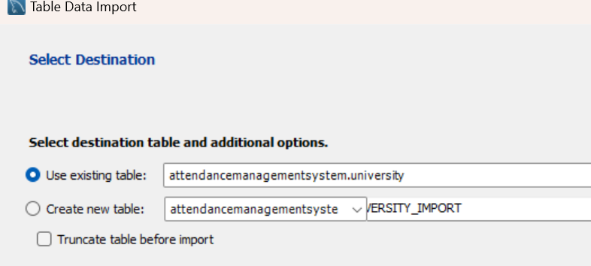
Data
Data Import Wizard

Slide 15
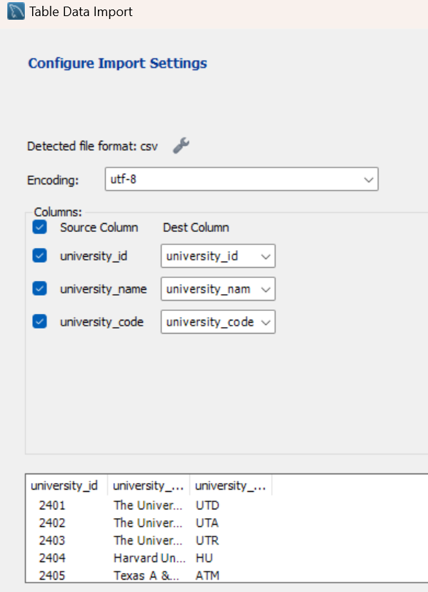
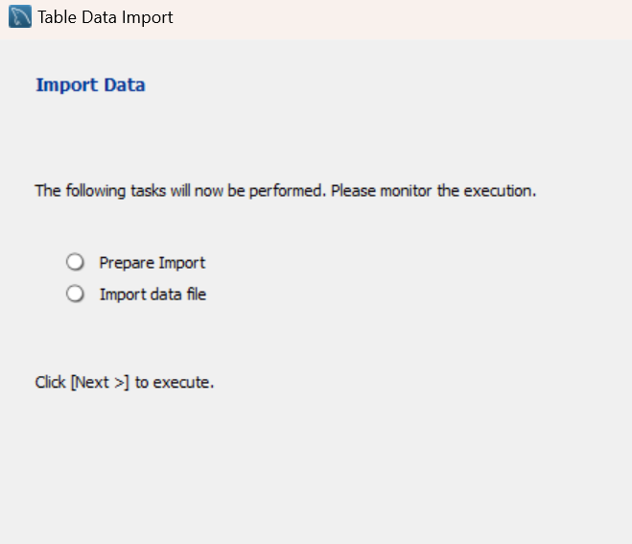
Data
Data Import Wizard

Slide 16
Queries
Fetching the Data

Slide 17
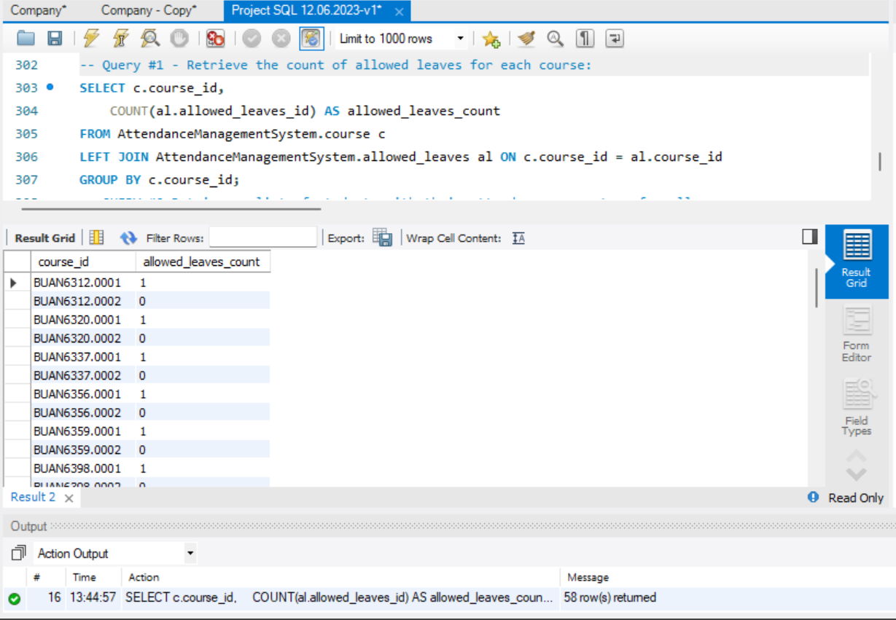
Query #1
Retrieve the count of allowed leaves for each course section

Slide 18
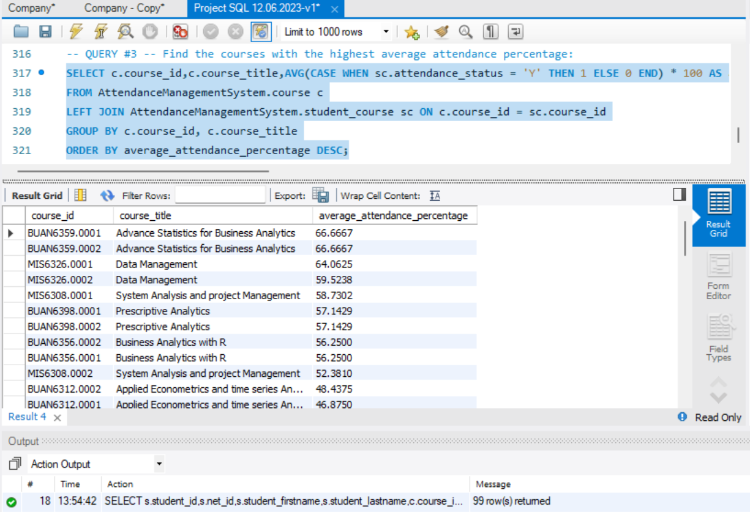
Query #2
Find the courses with the highest average attendance percentage:

Slide 19
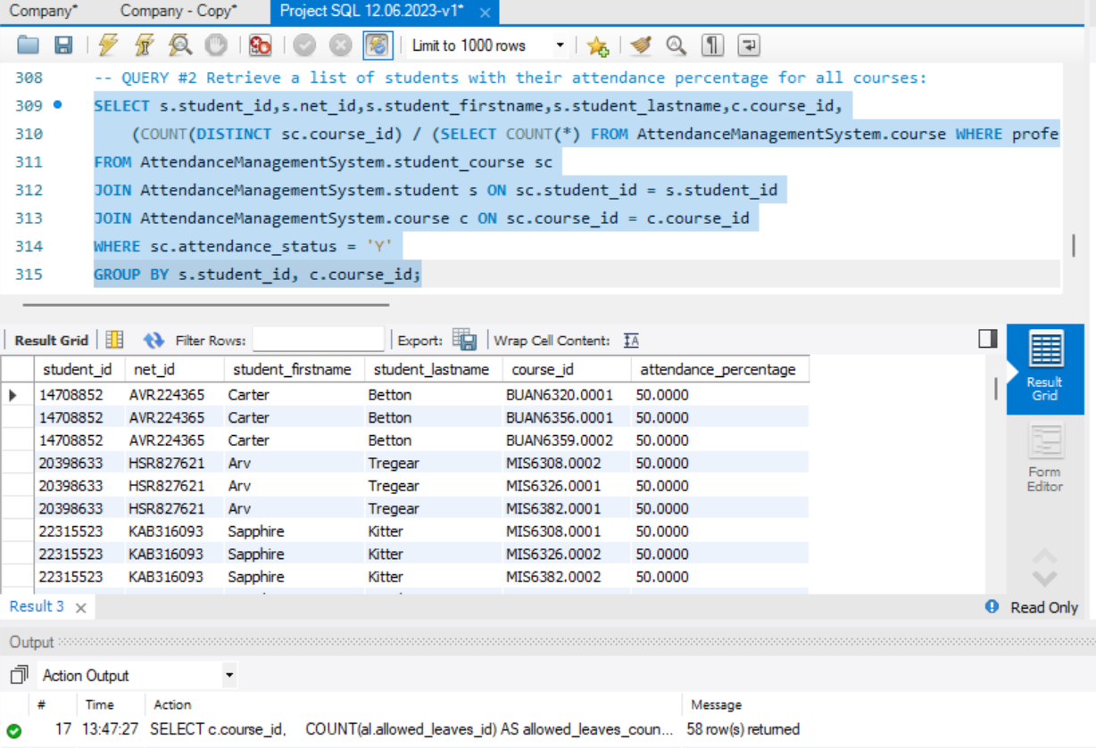
Query #3
Retrieve a list of students with their attendance percentage for all courses

Slide 20
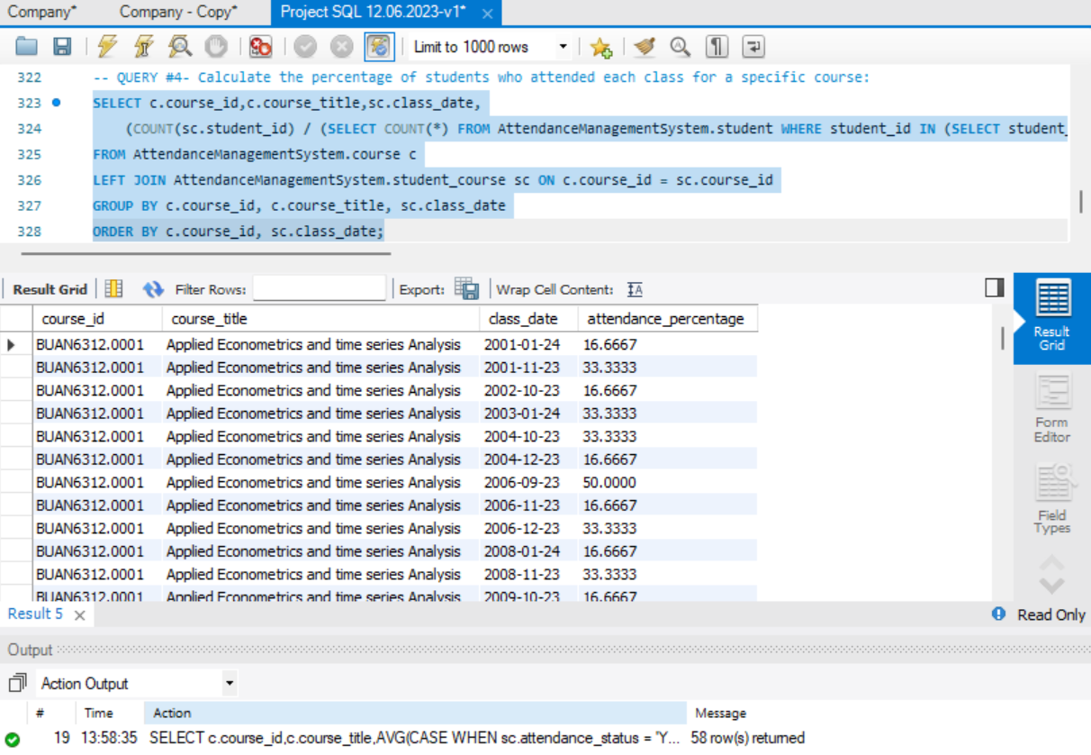
Query #4
Calculate the percentage of students who attended each class for a specific course

Slide 21
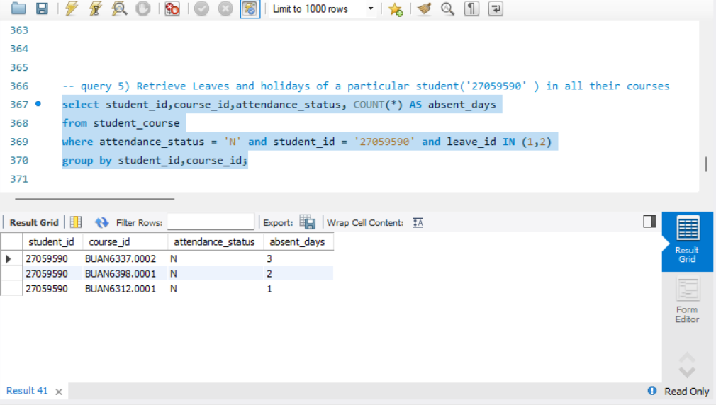
Query #5
Retrieve Leaves and holidays of a particular student('27059590' ) in all their courses
Add SS

Slide 22
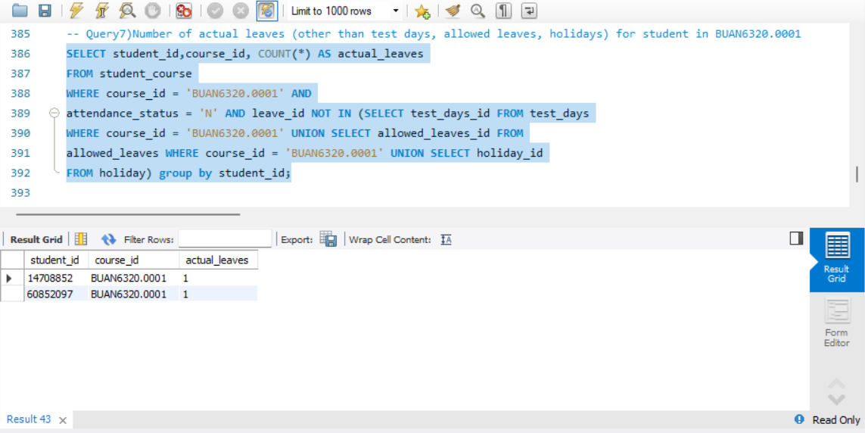
Query #6
Number of actual leaves (other than test days, allowed leaves, holidays) for student in BUAN6320.0001
Add SS

Slide 23
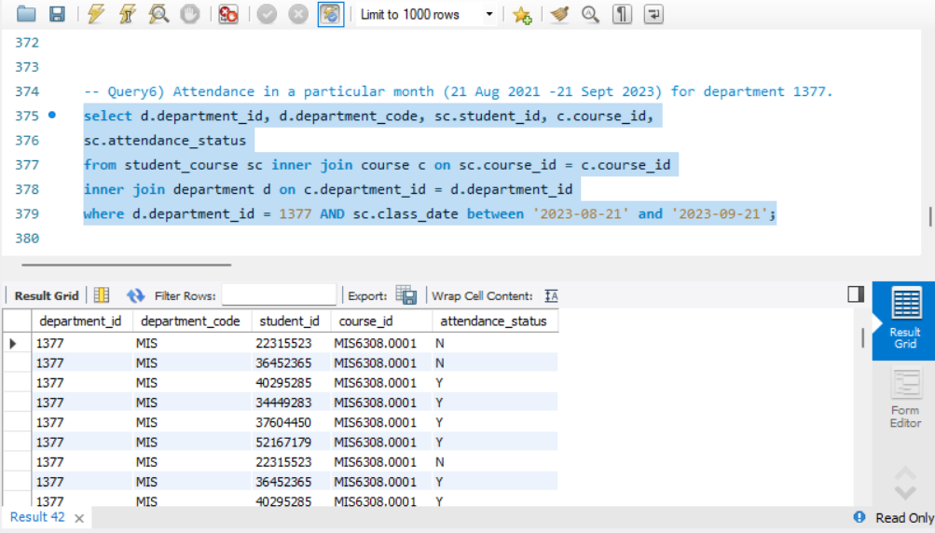
Query #7
Attendance in a particular month (21 Aug 2021 -21 Sept 2023) for department 1377
Add SS

Slide 24
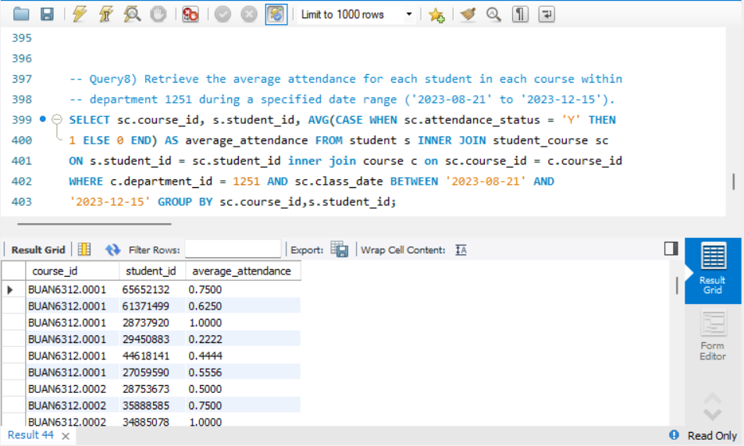
Query #8
Retrieve the average attendance for each student in each course within department 1251 during a specified date range ('2023-08-21' to '2023-12-15')
Add SS

Slide 25
User Interface
How would the application look
like to a User

Slide 26
Workflow
Login to the Attendance Management System.
1
Select the University,
Course/Section.
2
Add, Mark, or Track the attendance.
3
Submit the entry.
4

Slide 27
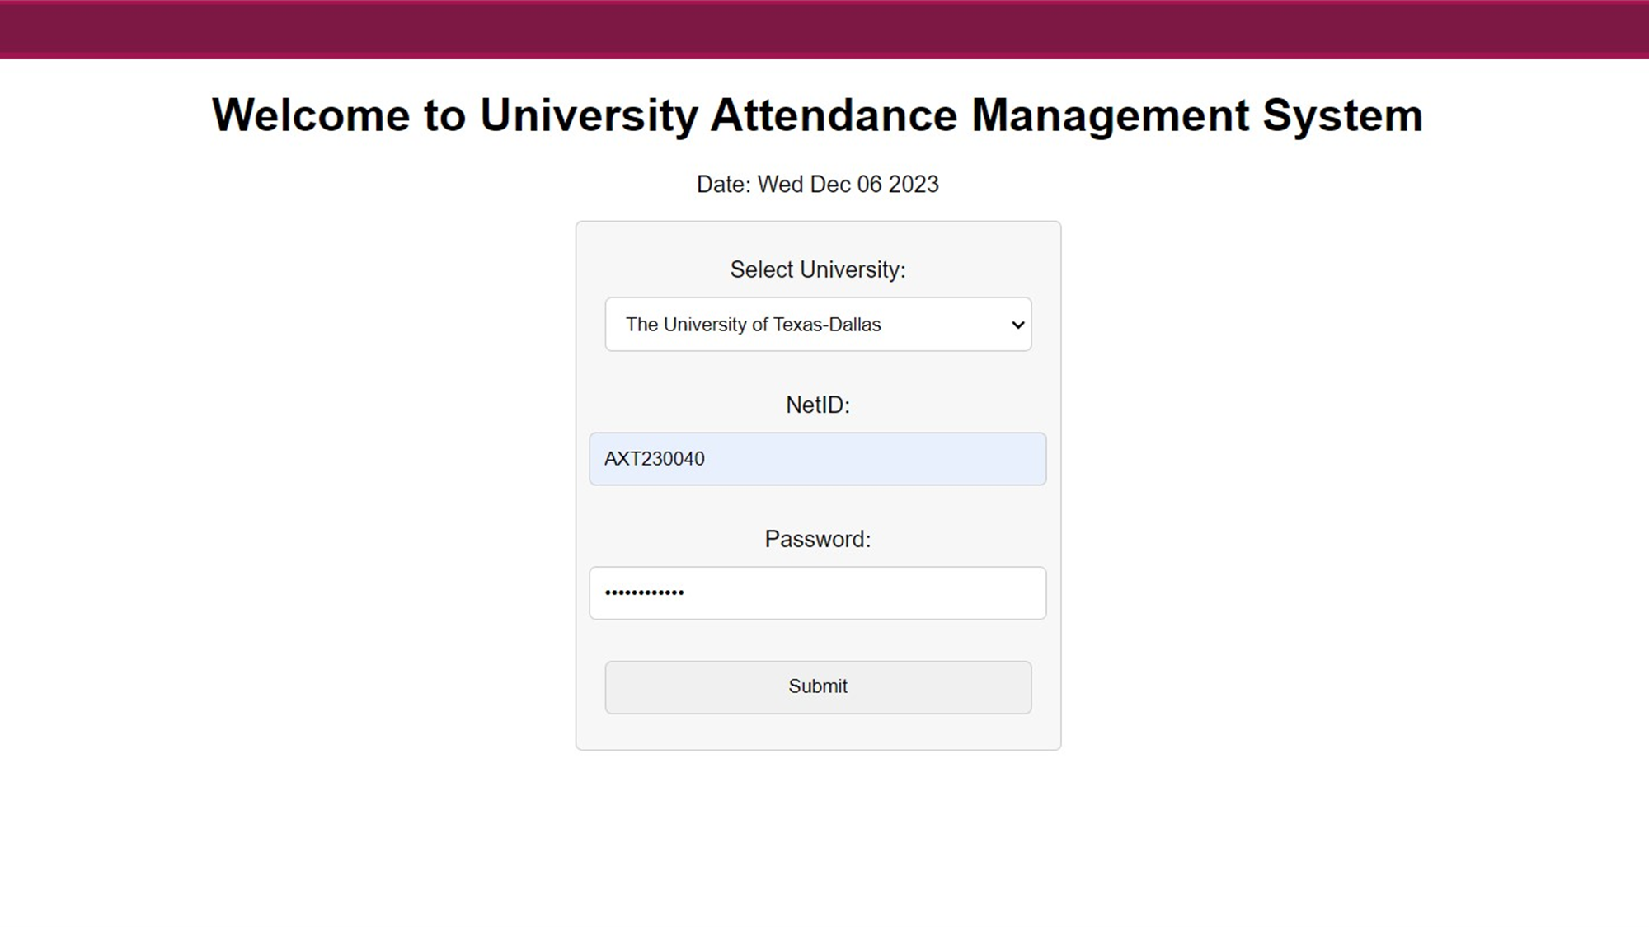
UI/UX
Screen 1

Slide 28
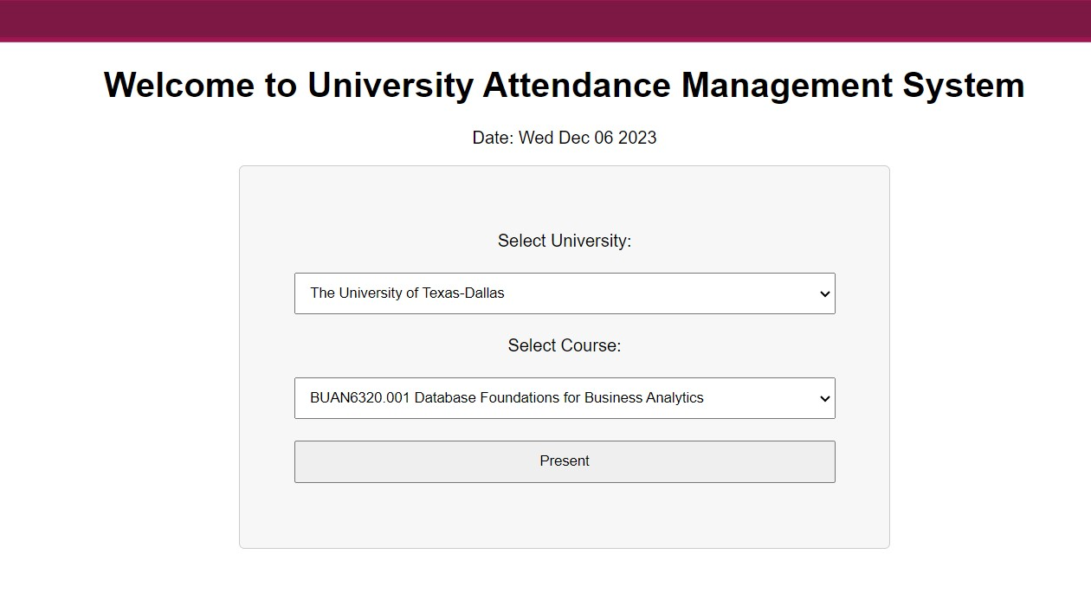
UI/UX
Screen 2

Slide 29
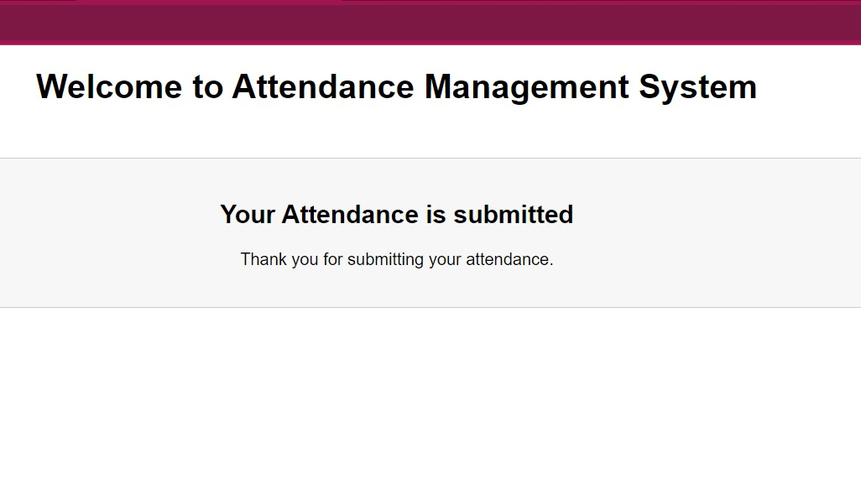
UI/UX
Screen 3

Slide 30
UI/UX
Screen 4

Slide 31
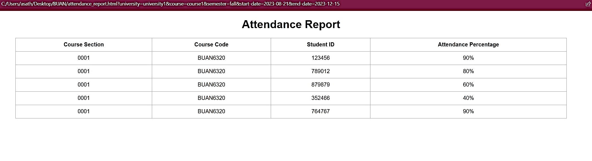
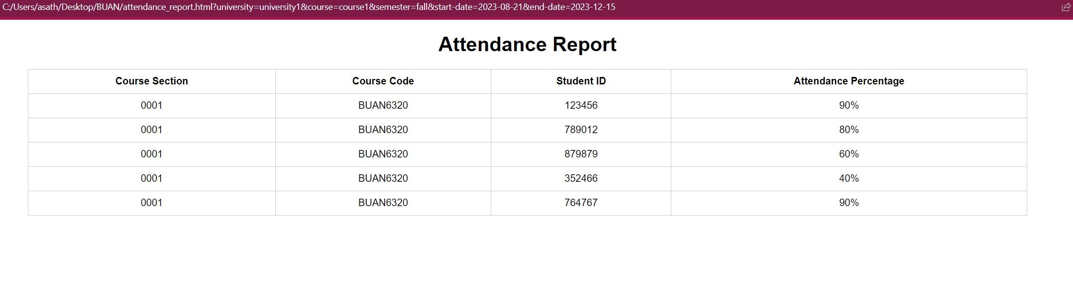
UI/UX
Screen 5

Slide 32

Summary
Comets Attend hence achieves the aim to have a central attendance tracking easy and save time for both professor and student.

Slide 33
Thank you

